Slide 1
USAGE BASED PRICING MODELS
STUDENT 1- 212FT116-SWETHA G STUDENT 2- 212FT114-SONIYA B
STUDENT 3- 212FT119-VYSHYA R
STUDENT 4- 212FT104-DHARSANA S

Slide 2
ABSTRACT:
Usage based pricing allows customers to pay for products based on the consumption that they do. This kind of pricing helps the customer to start from the low cost and then attract more customers to get started while still preserving the ability to monetize a customer over time. ‘Usage based pricing will be the key to successful monetization in the future’. Transitioning to a fully usage based model can be as seismic of a shift as going from on prem.

Slide 3
PROBLEM STATEMENT ADDRESSED:
PROBLEM 1: Sticker shock that can cause customer dissatisfaction – can degrade customers experience.
PROBLEM 2: Low switching costs-allows users to switch software.

Slide 4
EXISTING SOLUTION TO THE PROBLEM ADDRESSED:
PROBLEM 1- Be transparent about the cost, create controls for usage to give customer peace of mind- that’s for example give senior players the authority.
PROBLEM 2- Give support and service authority to discount to win back disgruntled customers.

Slide 5
PROJECT WORK PLAN:
1. Identify the right value metric and start simple-While usage-based pricing is typically priced around technical metrics (i.e. API calls, number of queries, etc.), they should be designed around value-based pricing principles.
2. Build Customer Monitoring, Alerting and Reporting-Due to the elasticity of usage-based pricing consumption, and in theory, unlimited consumption capability, you will want to deliver a certain level of monitoring, alerting and reporting to help customers manage costs, performance and the adoption of your solution.
3. Re imagine the Roles of Sales -The nuances of sales and customer success will be different with a usage-based pricing company. While customers can pay-as-you-go, it’s more common, especially for enterprise customers, to purchase annual usage commitments in advance to lock-in discounted pricing with payment upfront or as they are utilized.

Slide 6
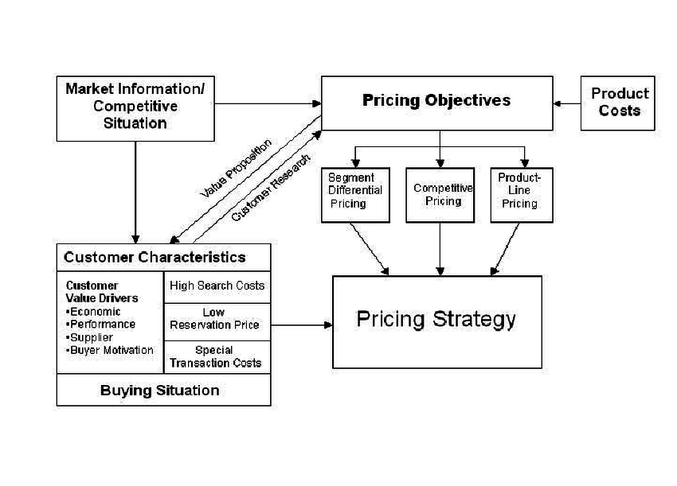
BLOCK DIAGRAM:

Slide 7
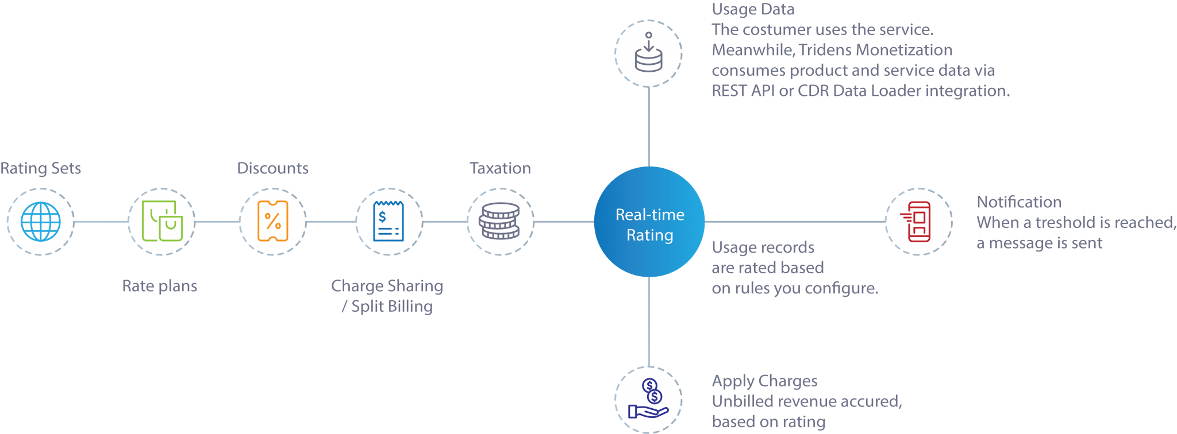
FLOW CHART:

Slide 8
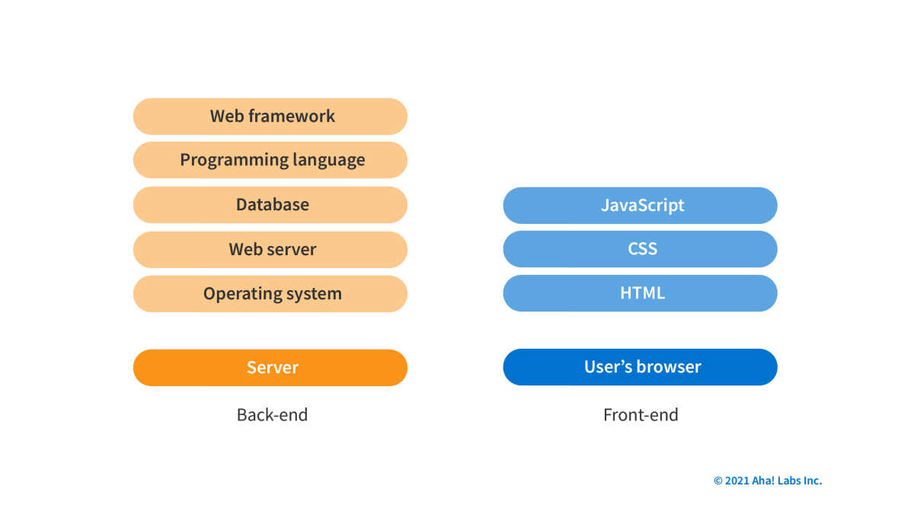
TECHNOLOGY STACK AND USE CASE:

Slide 9
REFERENCE:
www.techtaregt.com
www.openviewpartners.com
www.forma.ai

